Slide 1
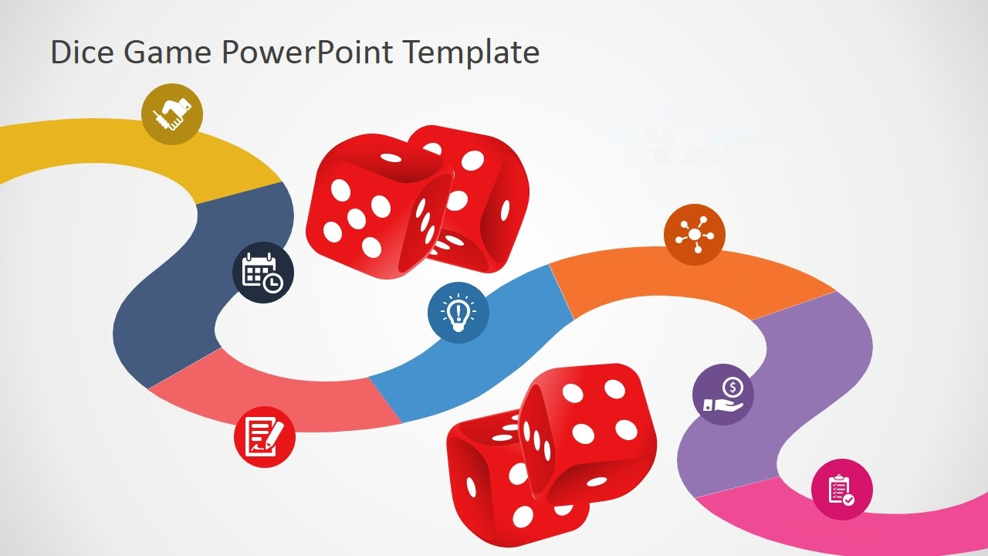
GO!
Guess What and GO!
Group 2B
FAMNAY
introduction
Game Description
Background research
Game features
FAMNAY
Purpose of the game
Summary
Franc Gripshi
Ana Peçini
Naisila Puka
Mustafa Bayraktar

Slide 2



Introduction
Play is one of the fundamental routes in which youngsters learn.
Play Fun Kids regularly turn out to be extremely caught up in what they are doing.
Playing helps children build up the capacity to learn.
Our educational game is the perfect balance of learning and leisure.
LEiSURE
LEARNING

Slide 3
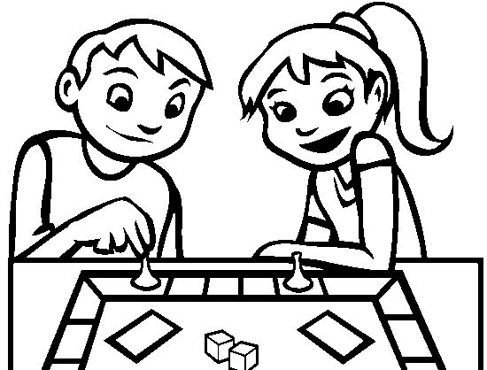
Game Description
Board game
Numbered and gridded squares
Multiple questions from different areas, which help or hinder the player’s progress.
The player(s) has/have to pass through challenges in order to make the way to the top.
Player(s) will get either a positive or negative evaluation.
Desktop game, written in Java code.

Slide 4
Purpose of the game and possible users
Within anyone’s reach ( child, adult, beginner , expert).
Mainly for young ages.
Different levels of difficulty
Prepares children for more formal school life.(easy)
Requires a wide knowledge of English academic vocabulary.(hard)
It can be played solo or with multiple players.

Slide 5
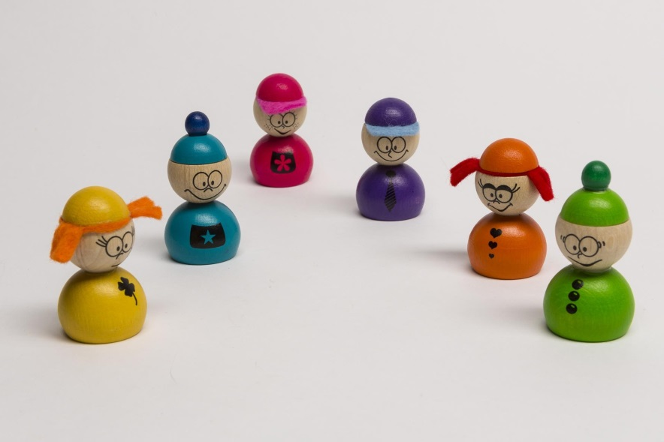
Game features
USERS
PAWNS
Anonymous (will not be saved)
Thus no need to log in or sign up for the game.
Enter your info and sign up! Be a gwager!
They will be designed in distinguishable shapes and colors.
Might look a little bit like these.

Slide 6
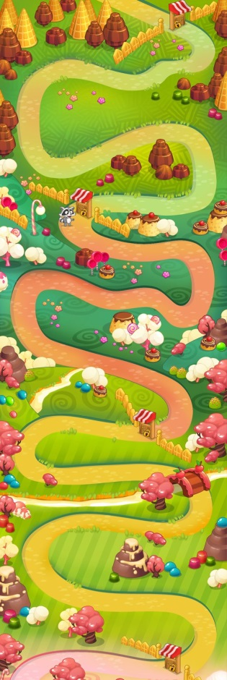
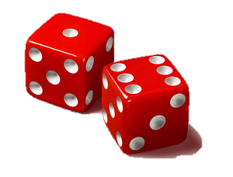
Moving vehicle of users.
BACKGROUND
DICE
A personally designed forest.
It will have gridded boxes through which the users will follow their path to the final box.
Similar to this.

Slide 7
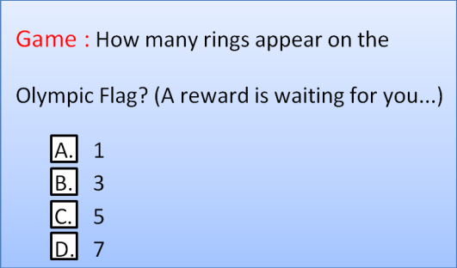
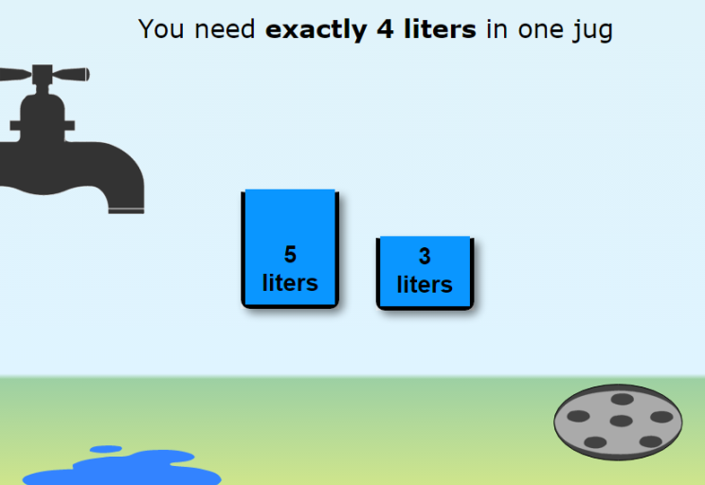
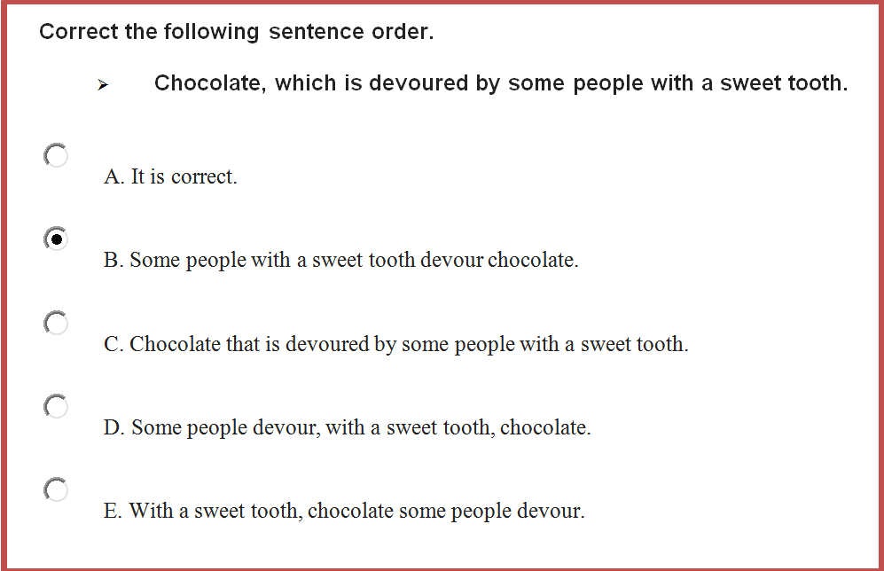
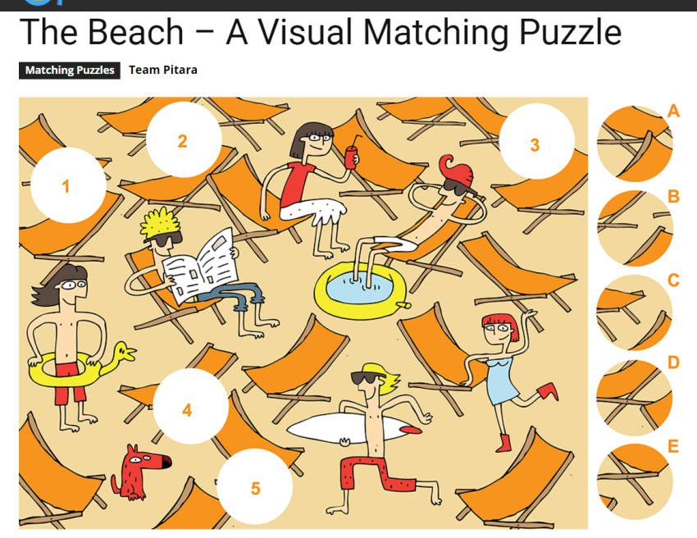
BOXES & CHALLENGES
Boxes can have bonuses and punishments.
When the user moves to a particular box after he /she rolls the dice, they receive a question.
Different areas, different levels of difficulty (which can be predecided.)

Slide 8
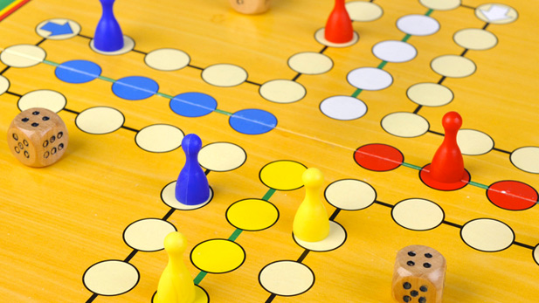
Background research
Sorry : A board game which is similar to ours in these aspects
First who goes through all the boxes wins.
One player eliminates the other if he goes to the latter’s exact spot.
However, our game differs because:
Path design will be an advanced background which will of course be user friendly.
Each player has exactly one representing pawn.
Game is focused on quiz/puzzle solving.

Slide 9

A game for those who seek to find, learning and leisure both combined! ©

Slide 10
References
How does technology impact your daily life : Gebski, Todd. https://www.motus.com/how-does-technology-impact-your-daily-life/ , 28/02/2017
How children learn through play : McKay, Steven. http://www.familylives.org.uk/advice/toddler-preschool/learning-play/how-children-learn-through-play/ , 28/02/2017
The Sorry Board Game Rules: How Do You Play the Sorry Board Game? : Coli, Amanda. http://howdoyouplayit.com/board-game-rules-play-board-game/ , 28/02/2017
Snakes and ladders - Postal Rules : Thomasson, Keith. http://www.fwtwr.com/postal_games/snakes_ladders.htm , version 3.0, 28/02/2017

